Slide 1

Team Name :
Team Size :
Problem Statement :
StackScore
Solo
Hire for how engineers actually work using
an AI-powered Full-Stack assessment framework

Slide 2
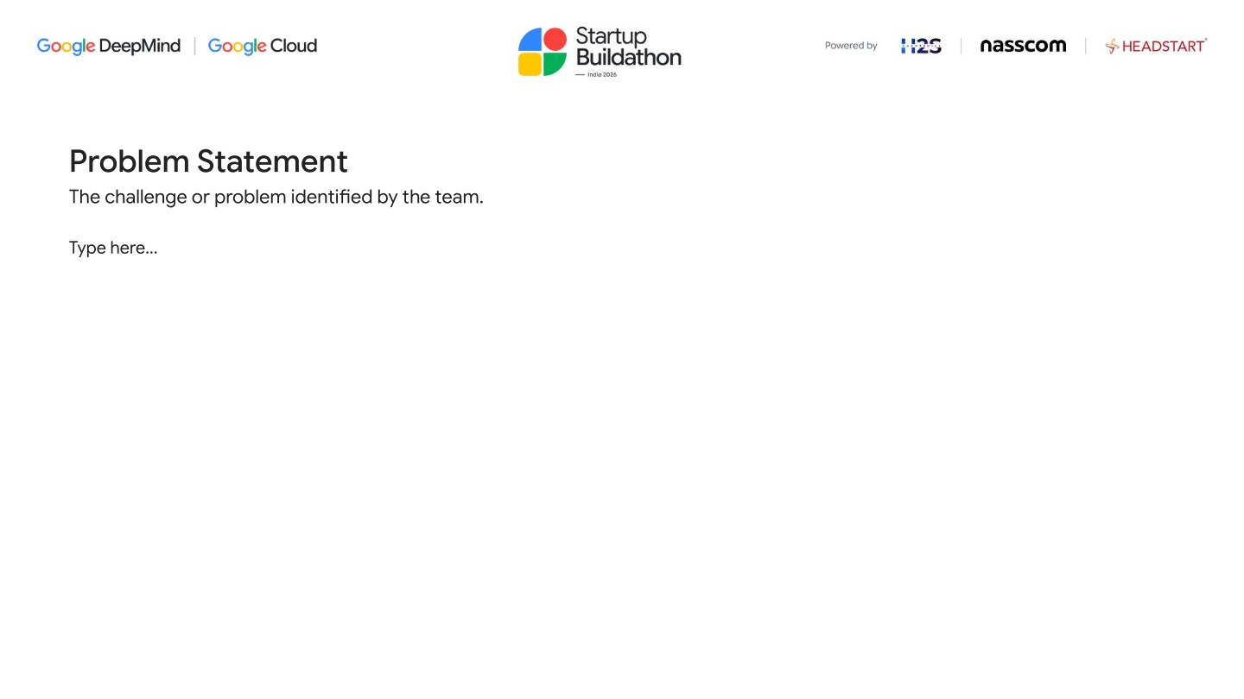
Problem Statement
The challenge or problem identified by the team.
Technical hiring measures what candidates memorize - not how they engineer.
01
02
03
Wrong Signal
No Standard Rubric
High Cost, Low output
LeetCode-style tests measure algorithmic recall and practice-driven pattern matching. They say nothing about system design judgment, requirements clarity, or adaptability under pressure - the skills that define a strong full-stack engineer.
Every panel interviews differently. Results are undocumented, uncomparable across roles or companies, and irreproducible. The same candidate passes or fails based on who happened to be available - not on structured capability.
A live system-design interview costs 2–3 senior engineering hours per candidate. No feedback is given to candidates. HR can't track or compare scores over time. There's no data layer for improving the process.
A candidate who aces dynamic programming may not design a URL shortener that survives a 10× traffic spike.
Hire decisions reduce to interviewer intuition, not documented engineering capability.
Companies spend hours per candidate and get a binary yes/no with no reusable signal.

Slide 3
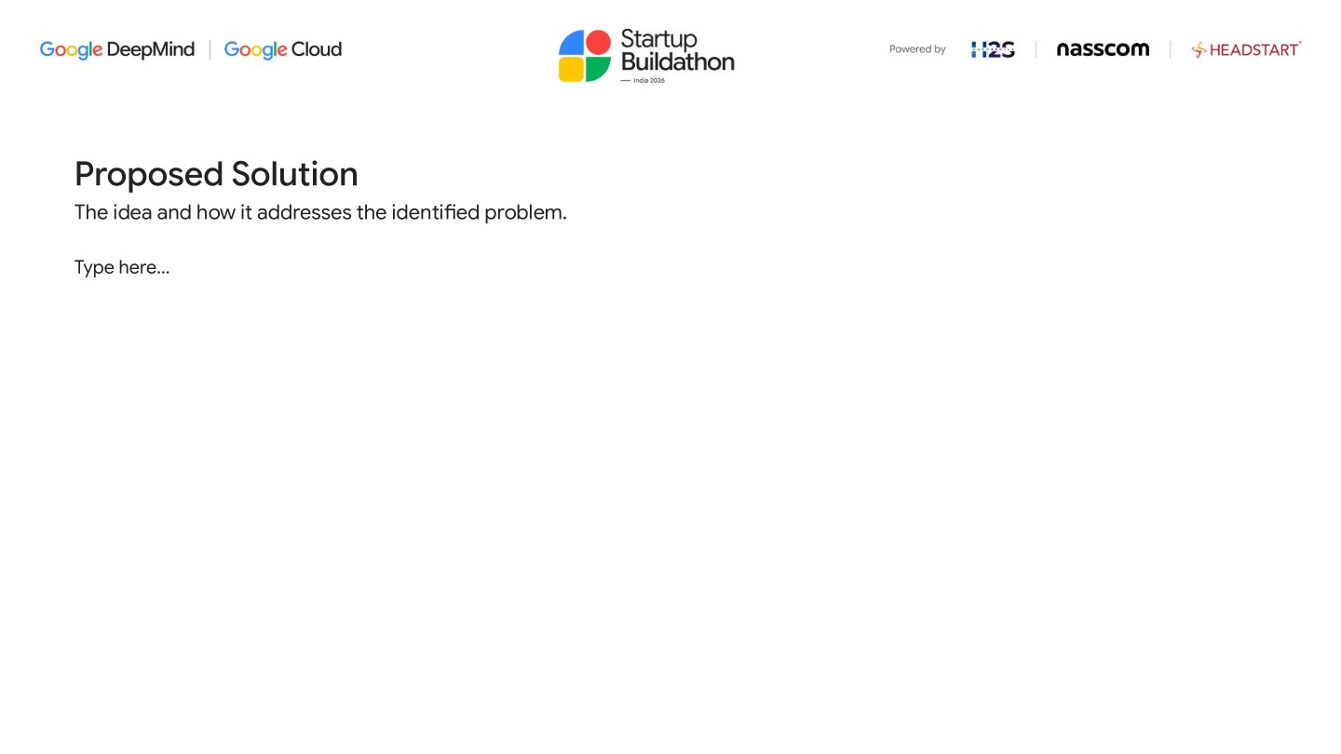


Proposed Solution
The idea and how it addresses the identified problem.
STAGE 1 . 5min
STAGE 2 . 10min
STAGE 3 . 20min
STAGE 4 . 10min
STAGE 5 . 15min
Clarify
Propose
Build
Adapt
Debug
Candidate Q&A with AI stakeholder to scope a deliberately ambiguous brief
Written system design against requirements uncovered in Stage 1
Code the core module; runs in a sandboxed Node.js executor
AI injects a mid-task constraint twist; candidate updates design & code
Candidate finds and fixes a subtle defect AI seeded into their own code
25 scenarios from a 5 × 5 matrix: problem domains × engineering constraint pillars
Gemini 2.5 Flash generates ·
Claude Opus 5.5 judges (adaptive thinking)
Output: StackScore 0–100 ·
role-calibrated · shareable URL

Slide 4
Scoring Rubric
One number. Ten dimensions. Zero interviewer subjectivity.
55 %
45%
Solution Design / Approach
Code-Level Best Practices
D1 Requirement Framing
Quality of clarifying questions; did they scope the real ambiguity in Stage 1?
D2 Architecture & Component Design
Soundness and clarity of the proposed structure
D3 Tradeoff Reasoning
Explicit justification of choices against the assigned constraint
D4 Constraint Satisfaction
Does the design actually hold up against the assigned pressure - not just mention it?
D5 Adaptability
How well the design absorbs the Stage 4 twist: patched vs re-architected vs collapsed
K1 Design-Code Alignment
Does the implementation match Stage 2 proposal? Flags drift.
K2 Correctness & Edge Cases
Does it work, including boundary and failure conditions?
K3 Code Quality & Maintainability
Naming, modularity, separation of concerns
K4 Security & Defensive Coding
Input validation, secrets handling, auth checks
K5 Testing & Observability
Tests written, error handling, logging and instrumentation present
K6 AI Collaboration Quality
how effectively candidates leverage AI tools - quality of prompting, verification, and knowing when to override.
Each axis independently scored 0–100 · StackScore = Σ(axis × weight)
Role-calibrated: Junior · Mid · Senior · Axis-independent scoring
prevents halo bias

Slide 5
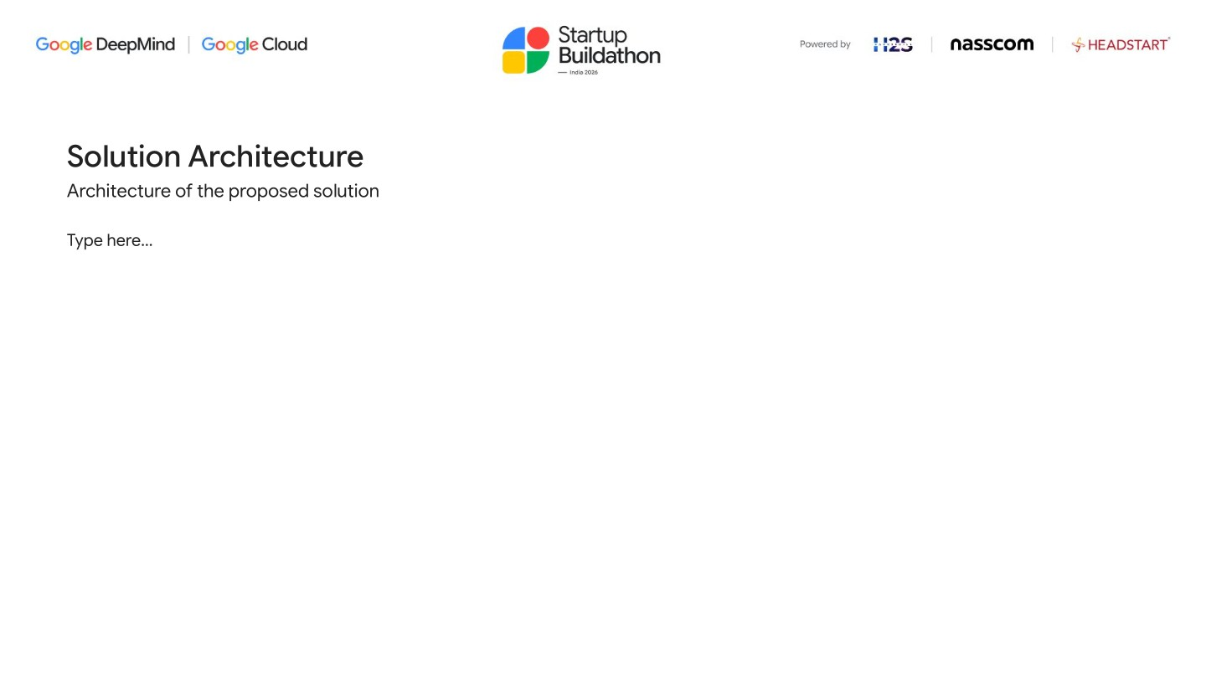
Solution Architecture
Architecture of the Proposed Solution.
GENERATION
Gemini 2.5 Flash
Brief · Stakeholder · Twist · Defect
JUDGING
Candidate
Next.js 14 App
Claude Opus 5.5
Cloud Firestore
/score/[slug]
Browser
Cloud Run · us-central1
10-axis rubric · adaptive thinking
Sessions · Transcripts · Scores
Shareable score card
EXECUTION
Node.js Sandbox
/dashboard
Code Execution
HR / panelist view

Slide 6
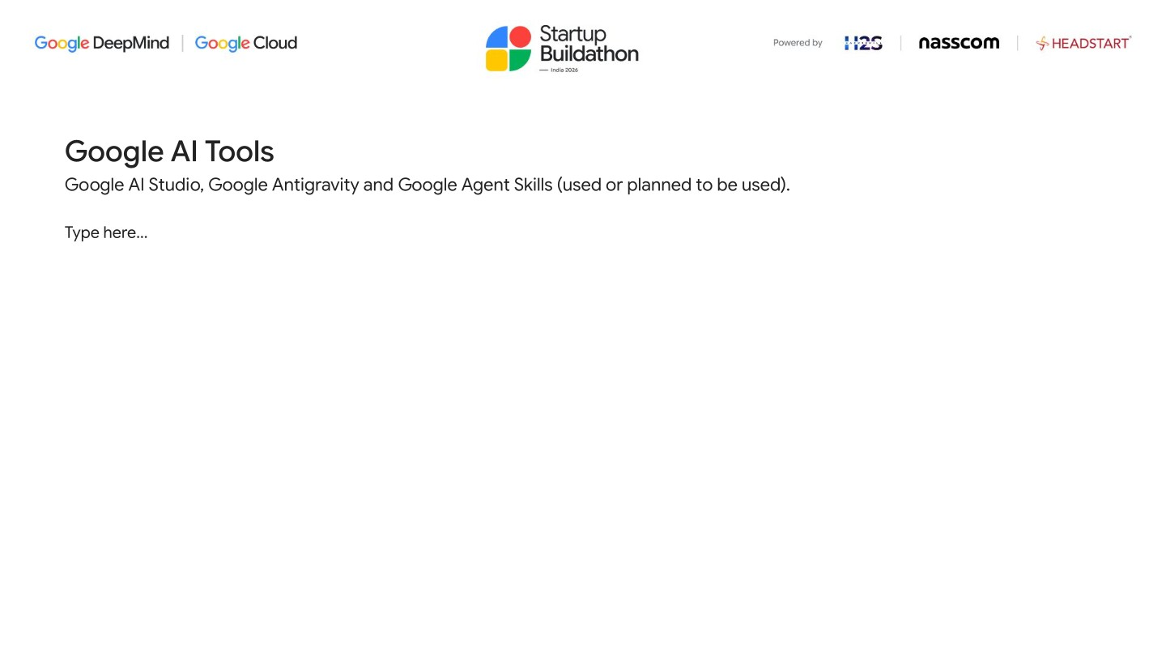
Google AI Tools
Google AI Studio, Google Antigravity and Google Agent Skills (used or planned to be used).
01
02
03
Google AI Studio
@google/genai SDK
Cloud Run
Gemini API key provisioned via AI Studio. Used in production for all generation calls - no Vertex AI billing complexity needed for the MVP.
Official JS SDK for Gemini API. genai.models.generateContent() powers brief generation, stakeholder voice, twist injection, and defect seeding.
Serverless container hosting for the Next.js app. Scales to zero between sessions; 512 MiB RAM, deployed automatically via Cloud Build CI/CD.
aistudio.google.com
model: "gemini-2.5-flash"
us-central1 · --allow-unauthenticated
04
05
06
Cloud Firestore
Cloud Build
Secret Manager
Document database storing sessions, stage-by-stage transcripts, and score cards. Queried in the HR dashboard for pass/fail threshold filtering.
CI/CD pipeline via cloudbuild.yaml. Builds Docker image, pushes with COMMIT_SHA tag, and deploys to Cloud Run in one gcloud builds submit command.
Stores GEMINI_API_KEY, ANTHROPIC_API_KEY, FIREBASE_PRIVATE_KEY. Injected into Cloud Run at deploy via --set-secrets. Zero secrets in source code.
sessions · transcripts · scores
cloudbuild.yaml · Docker · Cloud Run
--set-secrets KEY=secret:latest

Slide 7
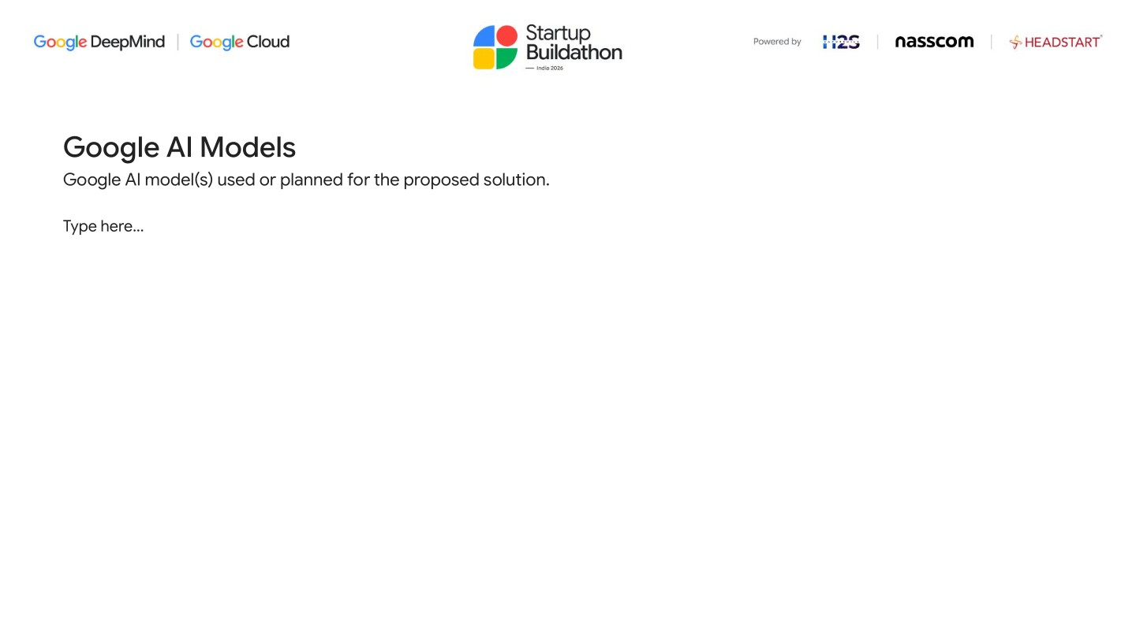
Google AI Models
Google AI model(s) used or planned for the proposed solution.
Gemini 2.5
GENERATION
Claude Opus 5.5
JUDGING
Claude Haiku 5.5
FALLBACK
via @google/genai · API Key mode
via Anthropic SDK · adaptive thinking
fallback generation
Problem brief generation - deliberately underspecified, stakeholder-framed, with hidden constraint woven in implicitly
Stakeholder voice simulation - answers clarifying questions in character without revealing the constraint category
Mid-task constraint twist injection - a natural "scope change from leadership" reframing the session's pressure
Debug defect seeding - plants one non-trivial logic error (off-by-one, missing edge case) in the candidate's own code
Rubric-constrained 10-axis evaluation - each axis scored 0–100 independently to prevent holistic-impression bleed
thinking: { type: "adaptive" } lets the model reason through nuanced design tradeoffs before committing to scores
Role-calibrated prompt - Junior/Mid/Senior expectation bars stated explicitly so the same rubric spans all levels
Returns strict JSON: axis scores + 1–2 sentence feedback per axis, persisted to Firestore and displayed on the score card
Activated when Gemini API is unavailable or returns empty — seamless in-session fallback
Runs the same generation prompts so the assessment never fails mid-session
Low-latency responses even under fallback conditions
genai.models.generateContent({ model: "gemini-2.5-flash", contents: prompt })
thinking: { type: "adaptive" }, model: "claude-opus-5-5", max_tokens: 4096

Slide 8


Slide 9


Slide 10


